Slide 1




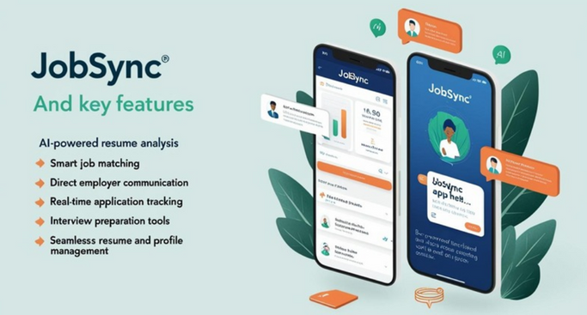
JobSync
Connecting Talent With Opportunity
Find Your Dream Job Faster & Smarter!
What is JobSync?
JobSync is a sleek and efficient job-searching app designed to streamline the hiring process, enhance communication between job seekers and employers, and provide AI-driven tools for career success.
Why Use JobSync?
🚀 Faster Hiring Process – No more waiting weeks for responses.
💡 More Opportunities – Connect with top companies and recruiters.
🎯 Increased Visibility – Get noticed by employers actively seeking candidates.
📊 Data-Driven Insights – Track how often your profile is viewed and improve your applications.

Slide 2

Sign Up & Create Your Profile – Upload your resume and set job preferences.
Explore Personalized Job Listings – Get AI-powered job recommendations.
Apply & Communicate with Employers – Track applications and get real-time responses.
Ace Your Interviews – Use AI-powered tools to prepare and stand out.
JobSync
JobSync
📲 Download JobSync Today!
Join thousands of job seekers who are landing jobs faster than ever before.
🔗 Website: www.jobsync.com
📧 Contact Us: support@jobsync.com
📱 Follow Us on Social Media: @JobSyncOfficial

Slide 3
Logo that was choosen

Slide 4

Runner Up logo

Slide 5
Both logos

